Slide 1
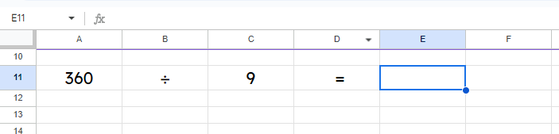
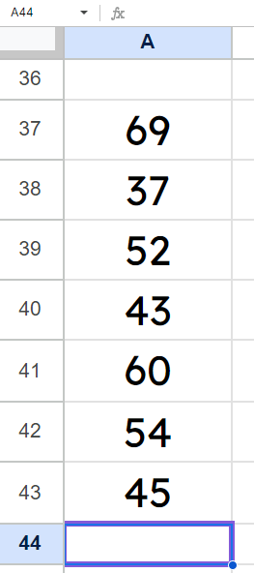
Constructing pie charts by utilising technology
All answers are accessed by clicking this link 🖇
Task A: Using spreadsheet functions to calculate angles
I want to type in the answer to this maths question in the cell E11.
cell E11 zoomed in
= A11 / C11
Click on the cell E11. You can check you have the correct cell by looking at the top left.
Press = to start a mathematical calculation.
Click on the cell with the first number you want to use in your calculation. In this question, click on cell A11, which contains the number 360.
Notice how your calculation shows the cell number A11, not the number 360. This is correct.
We want to divide, so on your keyboard, press the / button.
Click cell C11, the cell containing the second number in your calculation.
Press enter to complete your calculation.
1) Write in the correct spreadsheet function into the zoomed in cell E11 above to calculate the answer to the maths question 360 ÷ 9 =
It is very easy to add together large lists of numbers.
Click in the cell you want to have the total and type in:
=sum(
Then click, hold, and drag to select all the cells you want to add together.
Type the close bracket ), and press enter to perform your calculation.
2) Write in the correct spreadsheet function into cell A44 to calculate the sum of all of these numbers.
= sum (A37 : A43)
Google Sheets is a trademark of Google LLC and this content is not endorsed by or affiliated with Google in any way.

Slide 2
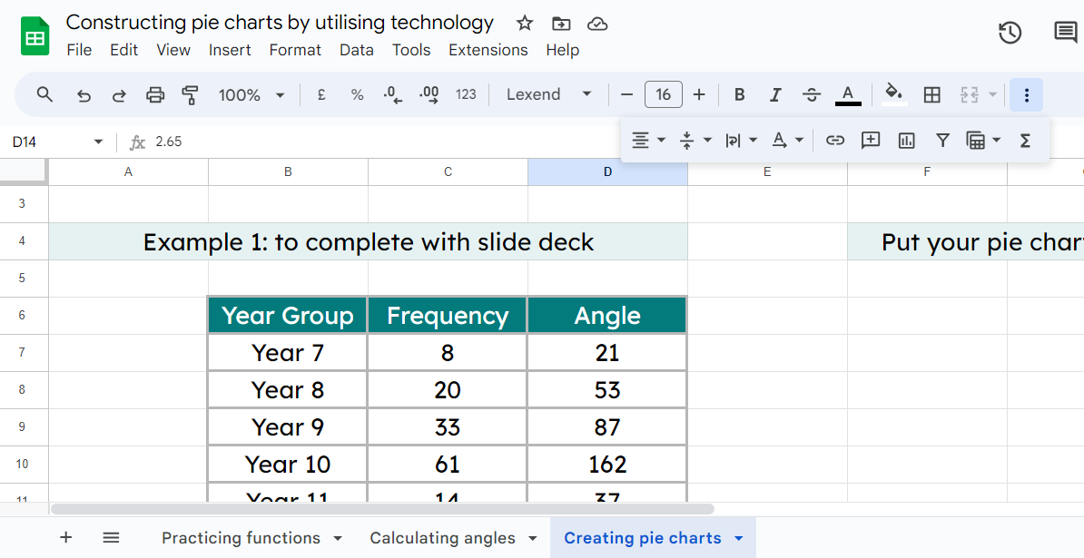
Constructing pie charts by utilising technology
A teacher collected data showing the number of students from each year group who attended homework club last week.
The teacher wants to represent this data as a pie chart using spreadsheets.
 | B | C | D
6 | Year Group | Frequency | Angle
7 | Year 7 | 42
8 | Year 8 | 36
9 | Year 9 | 36
10 | Year 10 | 30
11 | Year 11 | 48
12
13
14 | multiplier
= C7 * D14
= C8 * D14
= C9 * D14
3) Fill in each cell with the correct spreadsheet function to find:
= C10 * D14
= C11 * D14
the total frequency
the multiplier
the size of each angle
= sum (C7 : C11)
= 360 / C11
Task B: Using spreadsheet functions to calculate angles
If the Insert chart icon does not appear in the toolbar at the top of the screen to begin with, you can click on the three vertical dots on the top right to show further icons.
1) On the image above, circle the Insert chart icon.
Google Sheets is a trademark of Google LLC and this content is not endorsed by or affiliated with Google in any way.
Mathematics in Education and Industry

